Slide 1

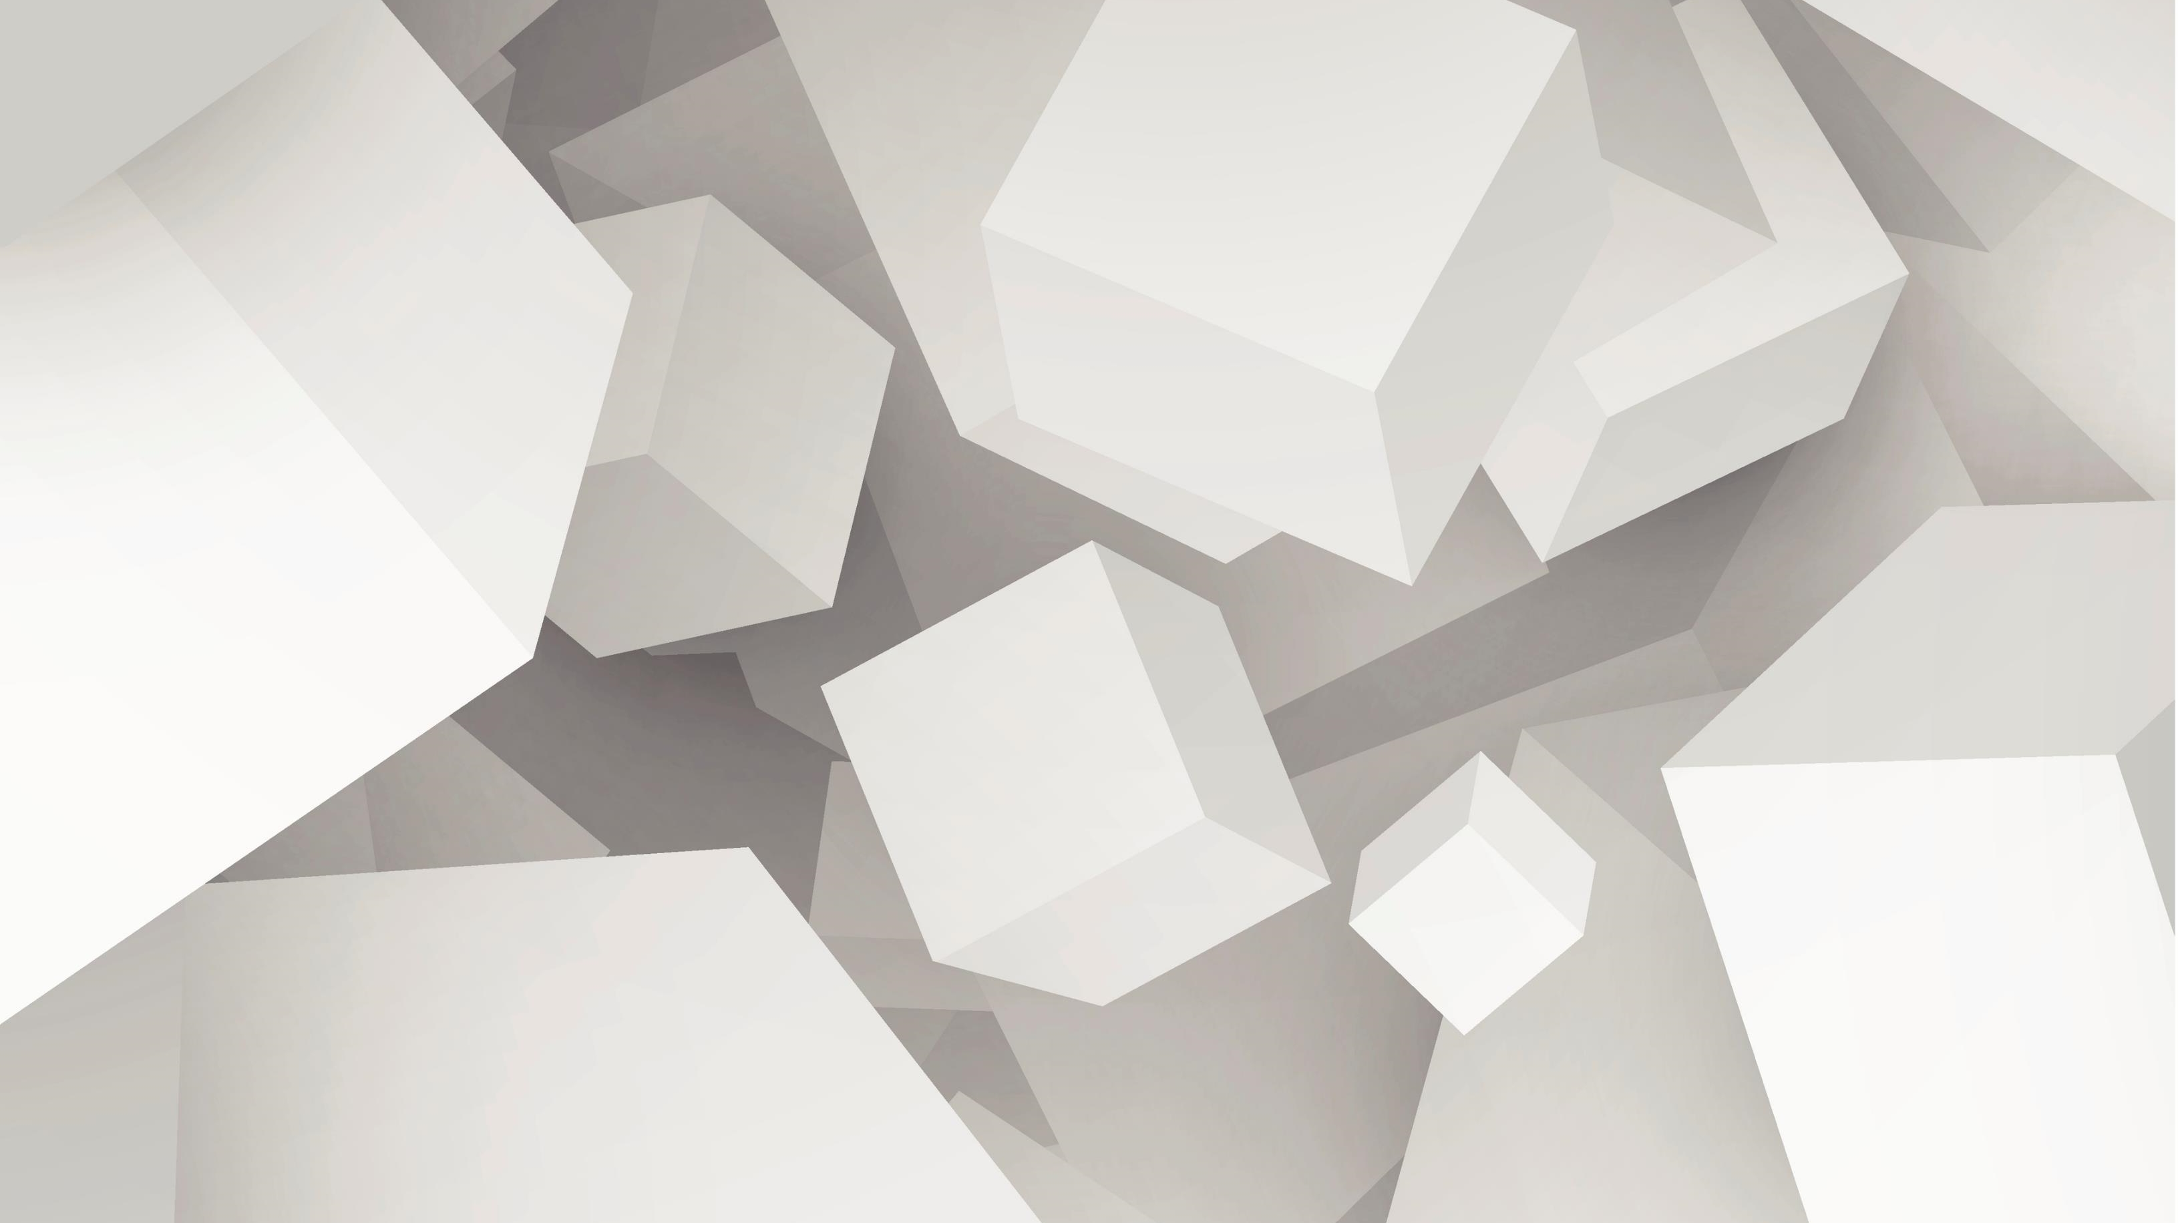

CHATBOT IN PYTHON
Submitted to : Garima Sharma
Submitted by : Syed Amaan Hasan
Section : E
University Roll no : 2019173

Slide 2


Content
Introduction
About Chat Bot
Language used
Output
Conclusion

Slide 3
Introduction
A computer program designed to simulate conversation with human users, especially over the internet.
We will be using Python language to create a chatbot using the chatterbot module.
ChatterBot is a Python library built based on machine learning with an inbuilt conversational dialog flow and training engine.
Installing package : pip install chatterbot

Slide 4
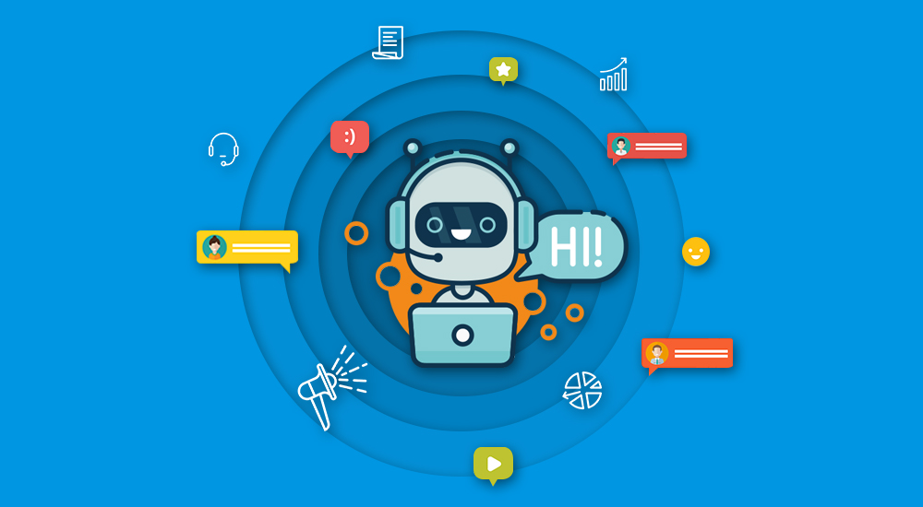
About Chatbot
Gives quick solution to complaints or queries.
Save human effort as it is available 24X7.
Reduce customer waiting time and efforts.
Supports multiple languages.
Understands customer requirements through Business Intelligence.
To the point answers to problems.

Slide 5
Understanding Chatterbot Library
It is developed to provide automated responses to user input.
It uses Machine learning algorithms and Natural Language Processing.
Chatbot library is language independent, giving it an edge in chatbot development.
The program picks the most appropriate response from the nearest statement available in the library that matches the user input.

Slide 6
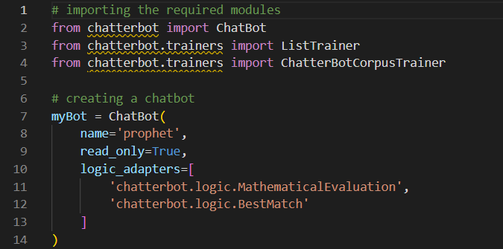
Preparing Chat Bot
Installing Modules
Chatterbot
Chatterbot.trainer
Creating ChatBot using chatbot functions.

Slide 7
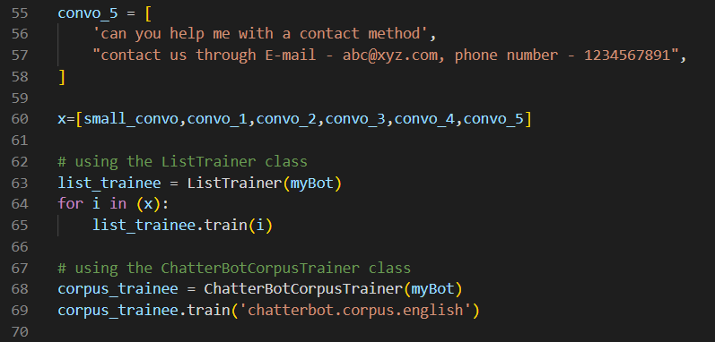
Adding custom conversation
Create conversation in the form of list, wherein string 1 is user input, and string 2 is response.
Using train() of chatbot trainer module to feed conversation to the chatbot.

Slide 8
Language Used : PYTHON
Due to its inbuilt ChatterBot module, which has numerous inbuilt functions.
Python being useful in Machine learning and Natural Language Processing.
Python has easier which which eases human efforts in writing program for ChatBot.
Python is platform independent which makes it easier to run chatbot on different platforms.
Python’s inbuilt libraries can be used to enhance the ChatBot such as for mathematical calculations, graphics etc.

Slide 9
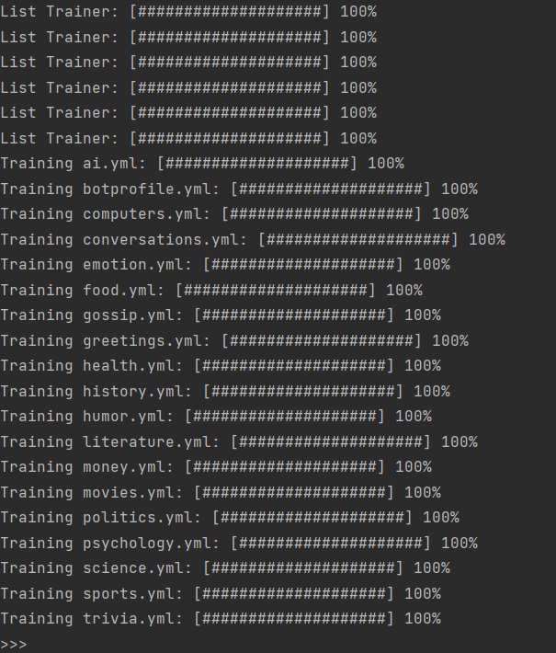
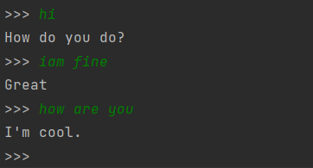
Output
Syntax to get responses from the chatbot is as follows:
myBot.get_response(“question”)
Where :
Get_response is an inbuilt function
myBot is the bot variable in which we created the chatbot
Training ChatBot with ML, and NLP
Conversation with ChatBot

Slide 10
Conclusion
In this project we learned :
How to build a chatbot.
Where chat bots are applied such as in business and webapps.
Using Chatterbot module.
Use of python in machine learning and Natural language processing.
Train chatbot with custom inputs.

Slide 11
Thank You

